Slide 1
All about Driving License in India
By
Archana Shagoti
Assistant Professor
KLSGIT, Belagavi

Slide 2
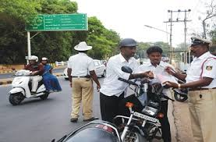

Slide 3
Our life is governed with the natural phenomenon of breathing in oxygen and releasing carbon dioxide.
This concept of life applies to all living beings on this planet. Here we understand that oxygen is essential to stay alive and that humans do not really have a choice. Just as we talk about life, a driving license in India is an essential document for car/bike owners and drivers. Without this official document, one can be liable to hefty fines and other consequences.
After all, a Driving license is a legal document that permits one to drive a specified vehicle. Driving any vehicle without a license can land you in the zone of troubles, including monetary compensations and disqualifications.

Slide 4
Why is the Driving License important?
Driving license in India is a permit to drive a specified category of the vehicle on the road, i.e a two-wheeler, four-wheeler or a commercial vehicle as well, within territorial boundaries.
Your Driving license is an official document issued by the Government of India to drive your car, truck, bus, bike, et all. It authorizes or clearly dictates that the owner knows how to drive the vehicle and has undergone tests that abide by the traffic rules and regulations.
Driving brings comfort and convenience in our life but it should not cause any damage to any third party.
Keeping this in mind, mature adults above 18 years of age are entitled to get a driving license. Anyone below this age is not permitted to drive. In case of a violation, the parents of the candidate can be legally held liable.

Slide 5
Different Types of Driving license in India
You can master the skill of driving any kind of vehicle but legally you cannot put it to use on the road unless you own a licence. In India, following are the types of licences available by the RTO.

Slide 6
1. Learner’s license
Before you get your permanent license, the Road Transport Authority issues you a learner’s license. The validity of the same is only for up to 6-months; which implies that you must polish your driving skills within this time frame.
Even when a toddler learns to take the first baby steps, we don’t leave them unattended. We try to watch each step and teach them to balance their body. In the same way, a learning license holder should not be left alone to drive. She/he should always be accompanied by a mature driver.

Slide 7
The conditions attached to provisional licences of a particular category of vehicle are:
L-plates must be conspicuously displayed on the front and rear of the vehicle.
Learner drivers of a particular category and transmission type of vehicle must be accompanied by somebody who has held a full driving license for that category and transmission type, except in the case of solo motorcycles and vehicles of certain categories designed solely for one person.
Motorcycle riders must not carry any pillion passenger.
Bus drivers must not carry any passenger except a person giving or receiving instruction.

Slide 8
Theory testing
Tests on basic driving rules are conducted at the RTOs when an individual applies for provisional licence. The theoretical test in India consists of basic road sign questions, which are the same for car and motorcycle tests:
Multiple choice questions – 15 questions with a choice of possible answers. At least 09 questions should be answered correctly to pass this section.
Verbal or written test (depending on the state)
The theory test are completed on the computer, and both must be passed in order to pass the theory test.

Slide 9
After passing a driving test, the provisional licence may be surrendered in exchange for a full Indian licence for the relevant kind of vehicle. Full car licences allow use of mopeds, motorcycles and cars.
A licence is valid for upto 40 years of age if applied before 30 years of age. Between 30-50 years of age it is valid till 10 years. From 50-55 year of age it is valid until holders 60th birthday. Above 55 years of age, it is valid for 5 years under motor vehicles amendment act 2019. The driving licence is required to be renewed after expiry of its validity. It was previously 20 years validity.

Slide 10


Slide 11
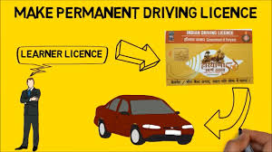

Slide 12
2. Permanent license
As soon as the waiting period of 6-months is over, the RTO issues a permanent license to the applicant. The age of the applicant should be 18 years old and she/he should clear the driving exam. The process of applying is made online and hence the complete process is pretty simple and hassle-free.
The permanent license is issued for private vehicles like cars and bikes. Issuing a permanent driver’s license means that the authority RTO is assured about the driving skills of the applicant
Just like when we find that the baby can walk on his own, only then we leave him to explore the world. Until then we tend to take extra care to prevent any kind of damage.

Slide 13
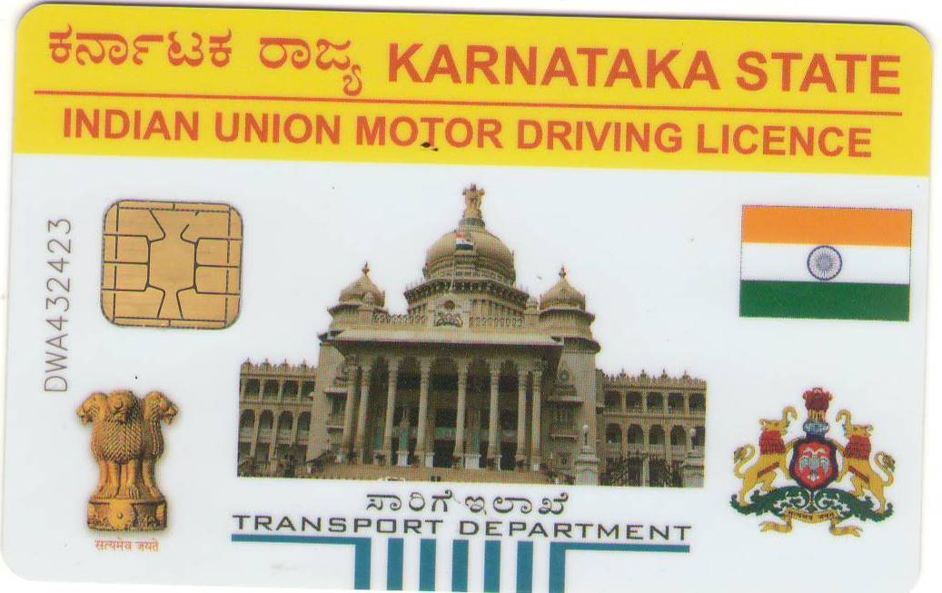

Slide 14
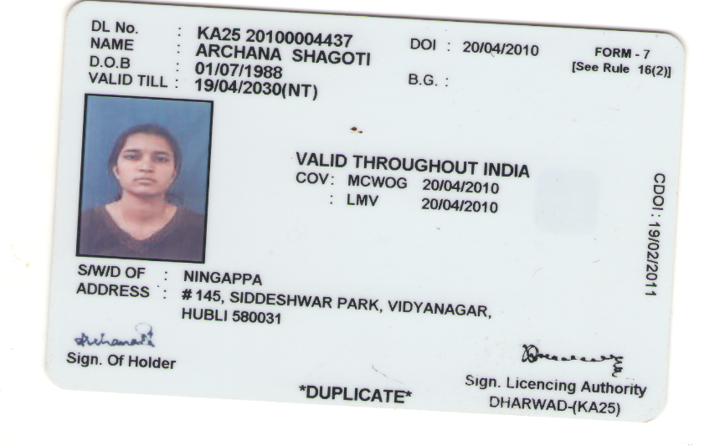

Slide 15
3. Commercial Driving license
This type of license authorizes the driver to drive heavy vehicles. Such kind of vehicle is used to transport passengers or goods. The minimum eligibility criteria to apply for a commercial driver's license is a bit different. Here, the candidate should have necessarily cleared the examination of 8th standard.
The responsibility of the commercial vehicle driver is higher as they are accountable for not only their safety but also of others.

Slide 16
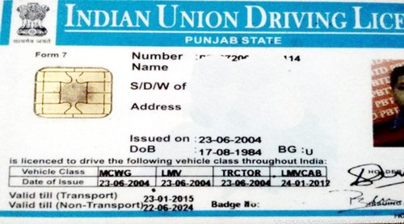

Slide 17
4. International Driving Permit
When an applicant looks for an international driving license it implies that the person is eligible to rent and drive any vehicle in a foreign land.
However, it can only be issued if you already have a permanent driving license. Unlike your driver's license, the IDP has a validity for 1 year only. And on the expiry, one would need to apply again.

Slide 18
Driving License Categories and Class of Vehicles in India
MCWG- Vehicles like motorcycles both with and without gear fall under this category.
HGMV- Vehicles like trailers, larger trucks, and other similar vehicles used for transport of goods fall under the category of HGMV.
HPMV- Vehicles that runs for commercial purpose and has an All India Permit to carry passengers falls under the HPMV category.

Slide 19
Driving License Categories and Class of Vehicles in India
MC 50cc- Vehicles that have an engine capacity of 50cc or less than that.
LMV-NT -Vehicles like jeep and motor cars fall under the Light Motor Vehicle Category but these are of non-transport class.
FVG- Vehicles without gears fall under this category like scooters and mopeds.
MC EX50CC- Vehicles like motorcycles with gears whose engine capacity is of 50CC or more.

Slide 20
Drawbacks of not owning a valid Driver's License
A driving license allows you to legally drive your vehicle on the road. It is a relevant permit from the government of India and hence driving without one is illegal.

Slide 21
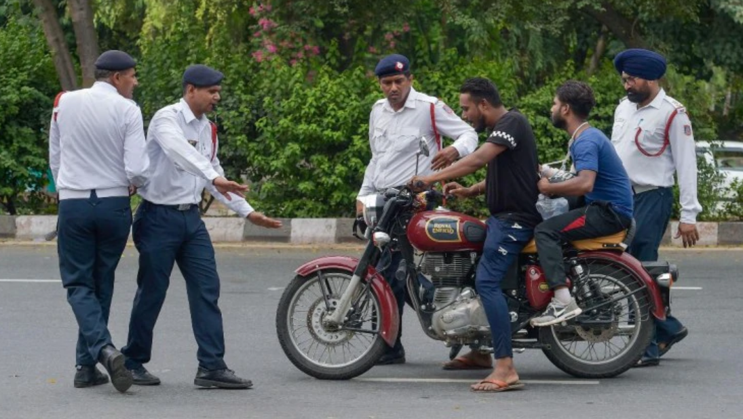

Slide 22
Driving without a DL
Increase in road mishaps have made it essential for the government to take strict actions towards those who do not drive carefully, and those who drive without a driving license (after all, your driving license is a permit that proves you know how to drive in the first place!)
Any person found driving without a driving license is liable for a fine of up to Rs 5,000 - depending on your state and vehicle.

Slide 23
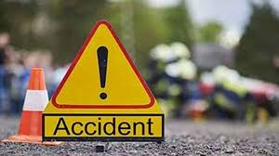
Driving without DL and cause accidents
If anyone who happens to drive a car without a license and meets with an accident, their license will be cancelled immediately. She/he will be charged a fine of Rs.5,000/- and/or imprisonment that may extend to 6 months for the first time. But on a second offence, the driver may be imprisoned for up to 1 year and/or be fined up to Rs. 10,000.

Slide 24
What to do in the following situations?
a. When you lose your license - If you happen to lose your driving license, immediately visit the police station in your locality and let them know. Complain and file an F.I.R. Then visit the notary office to get an affidavit signed which should inform that you have lost your driving license.
After you are done with the complaint, you can apply for a duplicate license enclosing your copy of affidavit and F.I.R.
b. When your license gets expired - If your license gets expired, apply for the renewal using Form 9 available at the RTO. You will then have to enclose your original expired driving license, passport size photographs, and radar card.

